Slide 1
Sn3O3

Slide 2
Sn3O3

Slide 3
TiO -2 layer
dmax=0.2
gauss
matern

Slide 4
TiO -2 layer
dmax=0.1
gauss
matern
No successes for dmax = 0.05

Slide 5
TiO -2 layer
dmax=0.2
dmax=0.1
dmax=0.05
No successes
Where dmax is the required maximum distance to the global minimum in the featurespace,
for a structure to count as a success.
The reason for no successes at dmax=0.05 is the limited precision because finite regularization.
The structures can therefore not be converged below a certain point.
In this case reg=10^-5. Lowering the regularization will probably allow for a finer convergence.
- Sadly the search fails for reg=10^-7. (probably numerical issues)

Slide 6
Sn3O3
Energy prediction of straight path
between the point in a search closest
to the global minimum and the
global minimum.
This suggests (not surprisingly) that
lowering the regularization and the
kernel width improves convergence.

Slide 7
TiO -2 layer
dmax=0.2
Some searches seam to get stuck in some low
energy configuration.
This is partly because the population is not very diverse, which results in less diverse new candidates.
As seen in the figure, increasing kappa helps.
Fixes for population:
Increase dmin criteria for entering population.
ML-relax populaton further, if structures from the same ML-minimum is present in the population.
Increase population size. (+ maybe pick parents with some energydependent weight)
Metropolis condition for entering population.
gauss

Slide 8
TiO -2 layer
dmax=0.2
Increasing kappa more does not further improve
The success curves.
The problem is probably that the relevant structures are not generated (due to non diverse population) - Improving the mutations might also help.
gauss

Slide 9
TiO -2 layer
dmax=0.2
Reducing the box height probably helps a bit,
But does not make a huge difference.
gauss

Slide 10
TiO -2 layer
The orange curve is the predicted energy of the global minimum, while grey curve is the best fitness at that iteration.
The plots of these six failed searches therefore show that the problem is that the proper new candidates are not generated by the
mutations. Since if they
were generated, they would be picked based on the energy alone.

Slide 11
TiO -2 layer
The variation in the population (controlled by d_pop) and the population size will influence, what new structures
are generated.
A very narrow population will result in the tendency
to get stuck in a local munimum.
Based on the the success curves there might be a benefit of
the d_pop=0.5, pop_size=10 settings compared to the settings
d_pop=0.2, pop_size=5 used in previous runs.
- But note that the searches are with 800 sp-calculations.
gauss

Slide 12
TiO -2 layer
Cut and splice does not seam to
contribute significantly.
The new rattle does not seam to
contribute significantly.
gauss

Slide 13
Double step – mathias’ best

Slide 14
Double step – new best

Slide 15
Double step – kernel width
Sigma=30
Sigma=10
Sigma=3

Slide 16
Double step – kernel width
Sigma=30
Sigma=10
Sigma=3

Slide 17
Double step – 2 best as refference

Slide 18
Double step – bias influence
Bias = mean(Etrain)
Bias = mean(Etrain) + std(Etrain)

Slide 19
Double step – Changing kernel width
Sigma=30
Sigma=10
Sigma=3

Slide 20
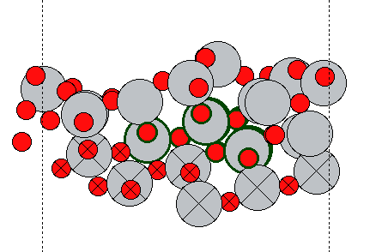
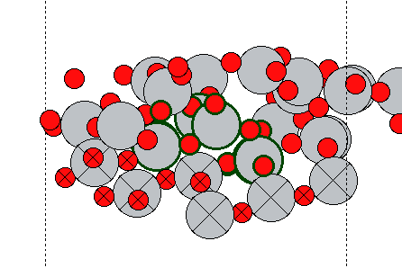
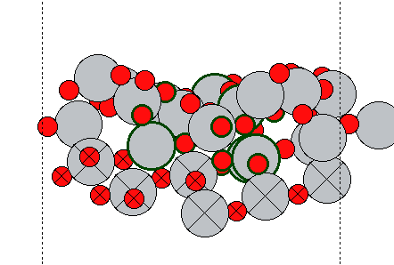
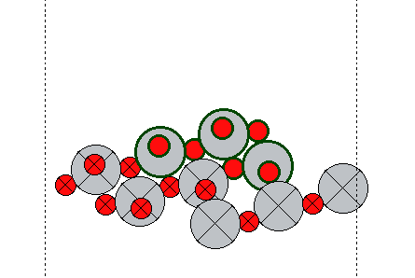
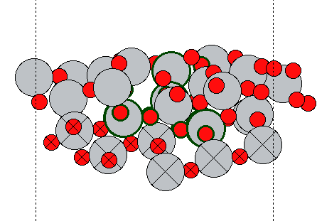
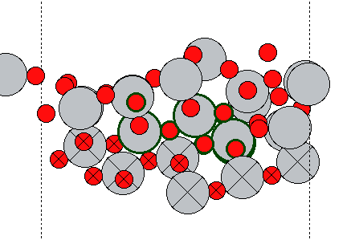
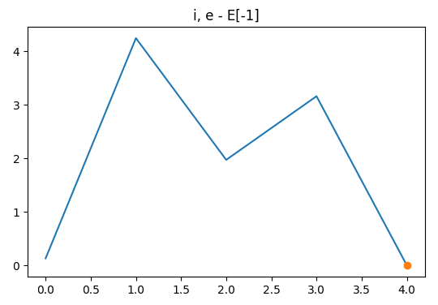
Double step
1
2
3
Slab
4
5
These examples show the best structures from 5 runs. There might be a correlation between the energy and the change in the position of the movable slab atoms. (these
does not take place in mutations, but only in model-relaxation)
=> Maybe they should therefor also take part in mutations.
E = -763.7
Eref = -763.3

Slide 21
Iterative GPR test – predict overall best

Slide 22
Iterative GPR test – predict best in run
reg1 = 1e-5
sigma2 = 3
sigma2 = 1
sigma2 = 0.01

Slide 23
Iterative GPR test – predict best in run
sigma2 = 3
reg1 = 1e-5
reg1 = 1e-4
reg1 = 3e-4

Slide 24
Iterative GPR test – predict best in run
sigma2 = 1

Slide 25
Iterative GPR test

Slide 26
Adaptive prior – 1d test data

Slide 27
Adaptive prior – step data
d_dilute=0.1
d_dilute=0.3
d_dilute=0.5
Testing on best structure from 8 different runs on the TiO double step system.
Training data: (based on data from a specific run that found reference structure 0 {place20_0.traj})
Single: all data.
Prior: all data diluted with “minimum allowed distance” = d_dilute.
Final: data diluted with d_dilute=0.1 and filtered by E < E_best + 10.

Slide 28
Adaptive prior – step data
d_dilute = 0.5, sigma2 = 2

Slide 29
Hyperparameter-search with prior-data gives around sigma=30
Hyperparameter-search with low energy data gives around sigma=8

Slide 30
Currently
TiO (DFTB): Running with new rattle
Step: running with new calculator.

Slide 31
To-do
TiO (DFTB): Run with setting that improve the diversity of the population.
Plot step features

Slide 32
Notes
TiO (DFTB): search fails when reg is lowered from 10^-5 to 10^-7

Slide 33
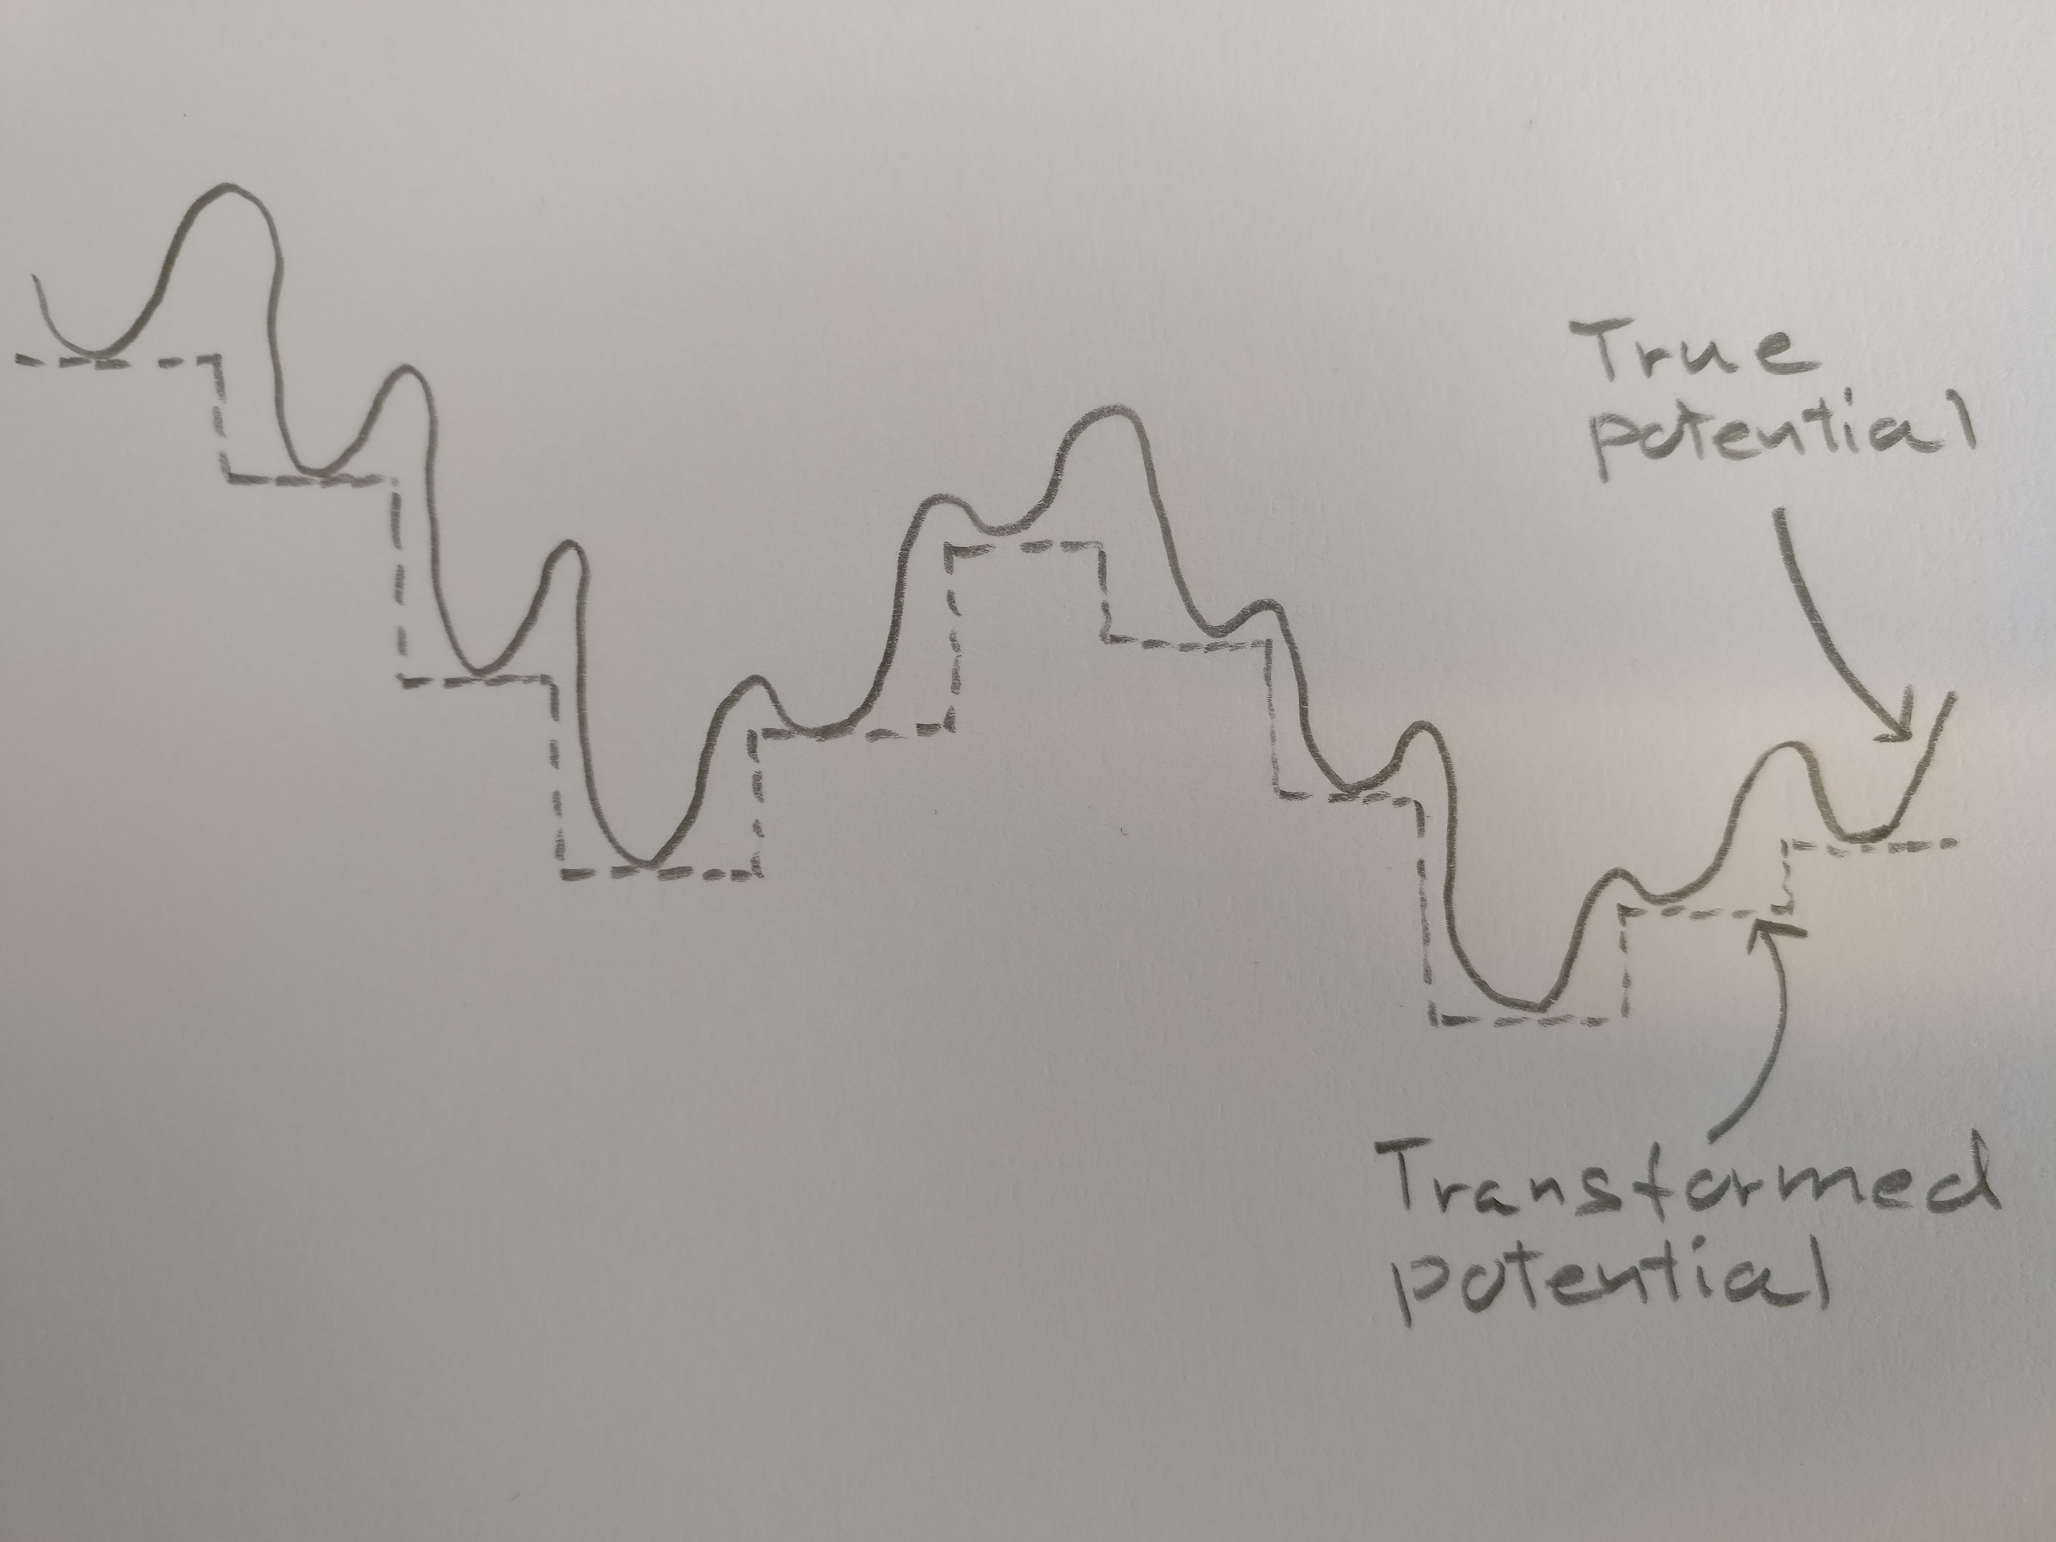
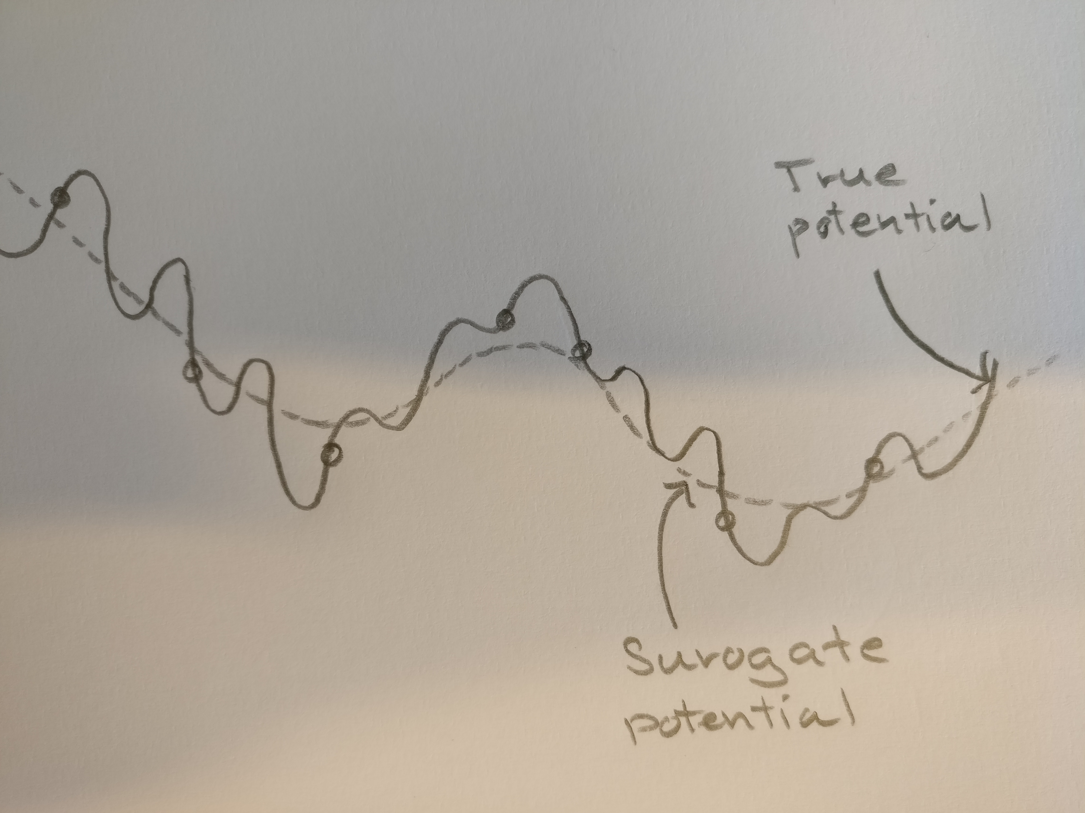
Notes
Traditional local optimization based structure search is equivalent to performing a search in an discrete transformed space as illustrated.
There are two disadvantages of such an approach.
The local relaxations are computationally expensive
It is a gradient-free potential opposed to a rough ML potential as pictured.

Slide 34
Local Features vs. Global features in structure search
For training a model to roughly learn the large-scale contours of the potential energy surface, global features are probably best, since they will result in a smooth surface.
On the other hand, the local approach, where learned local energy contribution are added to give the total energy, will probably contain more local minima as a result and might therefore not guide the search into the relevant region as well as possible.

Slide 35
Adaptive prior motivation
Observations:
The the configurational space for a given system is large, especially when you take non relaxed structures into account.
The interesting structures are located in a small region in this space. - Because all energetically favorable structures will contain close to same bond distances and angles, and also about the same number of bonds, as each atom will tend toward a specific number of bonds. - This might be less true for molecules.
A smart way to search with a surogate potential is therefore to have a rough model, which should
not concern itself with the fine details of the potential, but instead opt to effectively guide the search towards the low energy region(s).
One might then build another model on top, to be used for the finer search in the energetically
Interesting and much smaller region of space.

Slide 36
Notes
Gauussian process (GP) with an “adaptive” GP prior.

